Slide 1


CSS Selectors
By: Dalia Ihab

Slide 2


Element Selector
The element selector in CSS is used to select HTML elements which are required to be styled. In a selector declaration, there is the name of the HTML element and the CSS properties which are to be applied to that element is written inside the brackets {}.

Slide 3
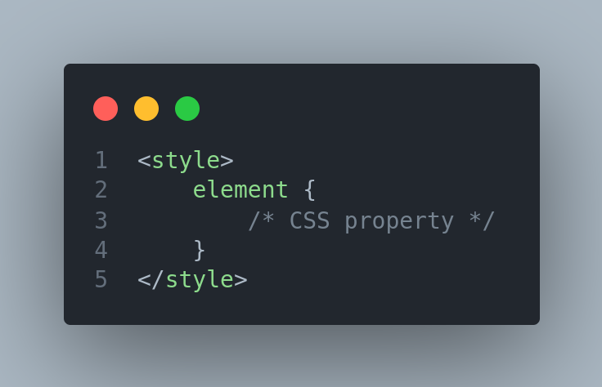
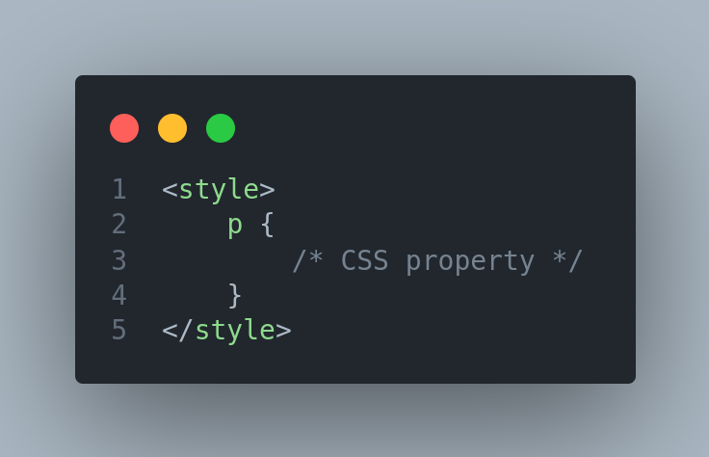
Element Selector

Slide 4
id Selector
The “#” CSS id selector is used to set the style of the given id. The id attribute is the unique identifier in an HTML document. The id selector is used with a # character.

Slide 5
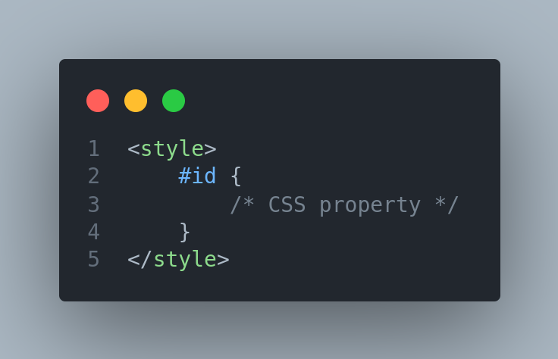
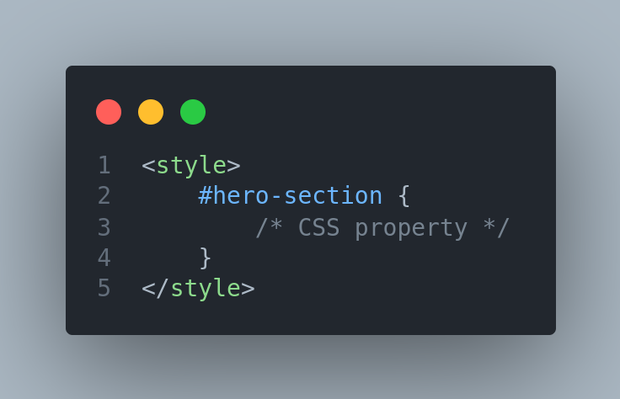
id Selector

Slide 6
Class Selector
The .class selector is used to select all elements which belong to a particular class attribute. In order to select the elements with a particular class, use the period (.) character specifying the class name ie., it will match the HTML element based on the contents of their class attribute. The class name is mostly used to set the CSS property to a given class.

Slide 7

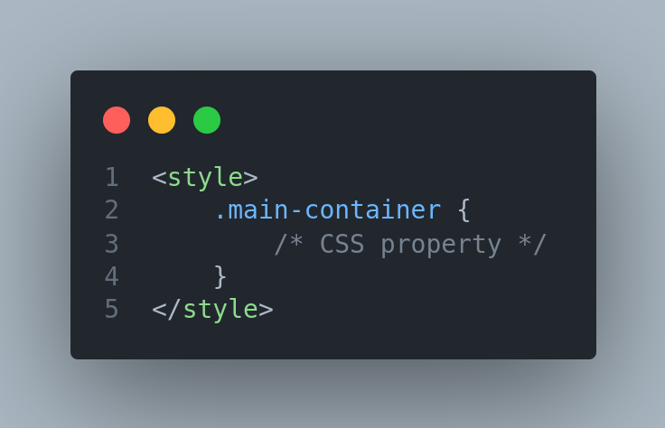
Class Selector

Slide 8

Universal Selector
The universal selector (*) selects all HTML elements on the page.

Slide 9

Descendant Selector
The descendant selector matches all elements that are descendants of a specified element.

Slide 10

Child Selector
The child selector selects all elements that are the children of a specified element.

Slide 11
Priority based on CSS type
High
id Selector
Class Selector
Element Selector
Low

Slide 12
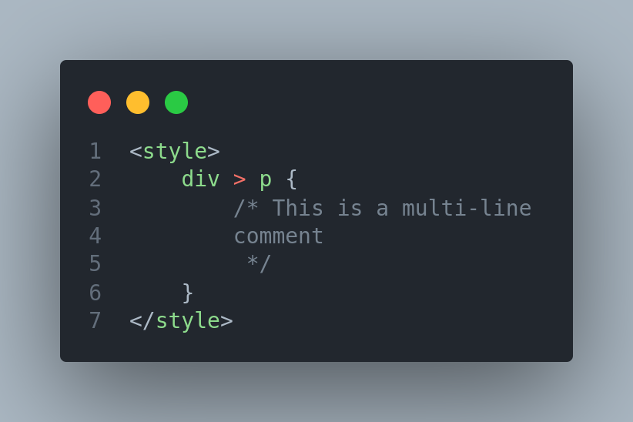
CSS Comments

Slide 13


Next
Font Properties

